Slide 1

Team….

Slide 2
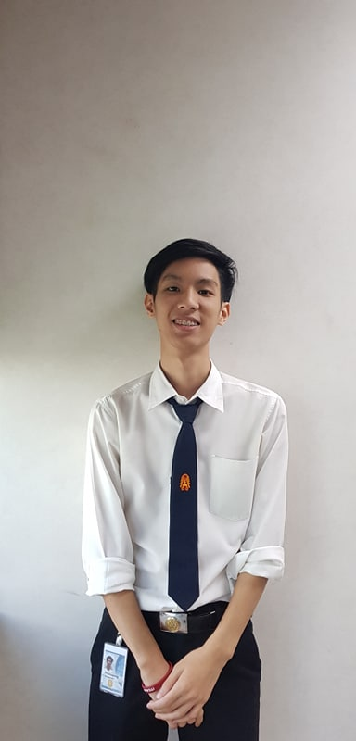
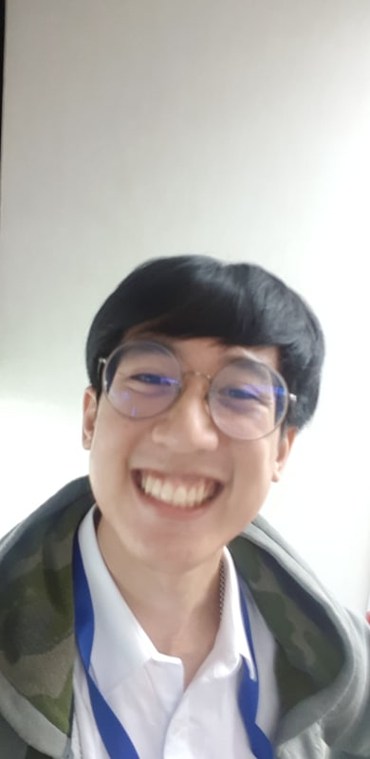
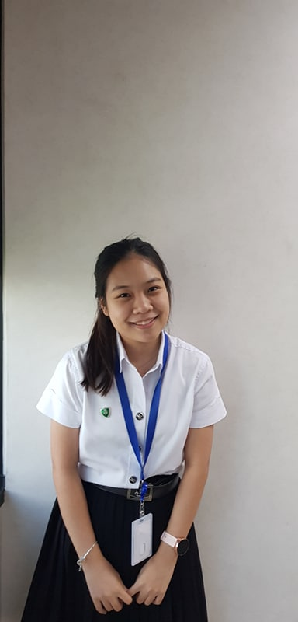
Introduction
Phanupong Rangsanseri
Warrawit Patanavanich
Weeya Weerawatpruchya
IT KMITL
Computer Engineer KMITL
Computer Engineer KU
Earth
Joe
Boo

Slide 3

Agenda
Internship expectation
Team background
Pain point & Solution
Work process
Demo
Intern life

Slide 4

Internship
expectation
Team
background
Work
process
Intern
life
Pain point
& Solution
Demo

Slide 5

Expectation
Working
experience
Technical
skills
Finding myself
New friends
Internship
expectation
Team
background
Work
process
Intern
life
Pain point
& Solution
Demo

Slide 6



Financial Upstream SAP
EMIT Financial
Upstream SAP
Upstream business
Internship
expectation
Team
background
Work
process
Intern
life
Pain point
& Solution
Demo
Notes:
Which each team responsible for support FI Upstream(non-EMIT) in different region. And we're in Thotsakan team.

Slide 7


Financial Upstream SAP
Polaris
Supernova
Thotsakan
4 teams
Scrumblers
Internship
expectation
Team
background
Work
process
Intern
life
Pain point
& Solution
Demo
Notes:
EMIT FI Upstream team separate to 4 teams, Thotsakan, Scrumblers, Supernova and Polaris.

Slide 8
Why tickets are important?
Notes:
Critical to business ---- example

Slide 9










Thotsakan
Scrumblers
Supernova
Users
Dispatcher
Polaris
IT Console
Internship
expectation
Team
background
Work
process
Intern
life
Pain point
& Solution
Demo
Notes:
(Animation) Users report problem/issue as a ticket and we have ticket dispatcher to monitor tickets and assign that ticket to team member for solving problem

Slide 10
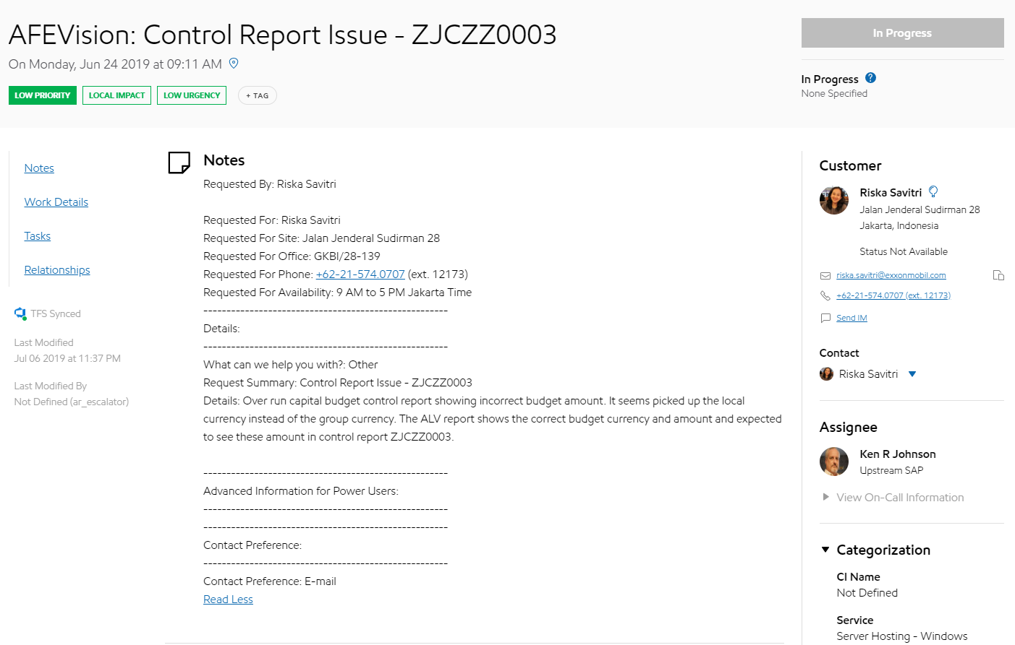
Ticket
Summary
Customer
Details
Notes:
Let’s take a look at real ticket
In the ticket will have summary of tickets (title), detail that customer write to explain more about their problem, customer who open the ticket

Slide 11
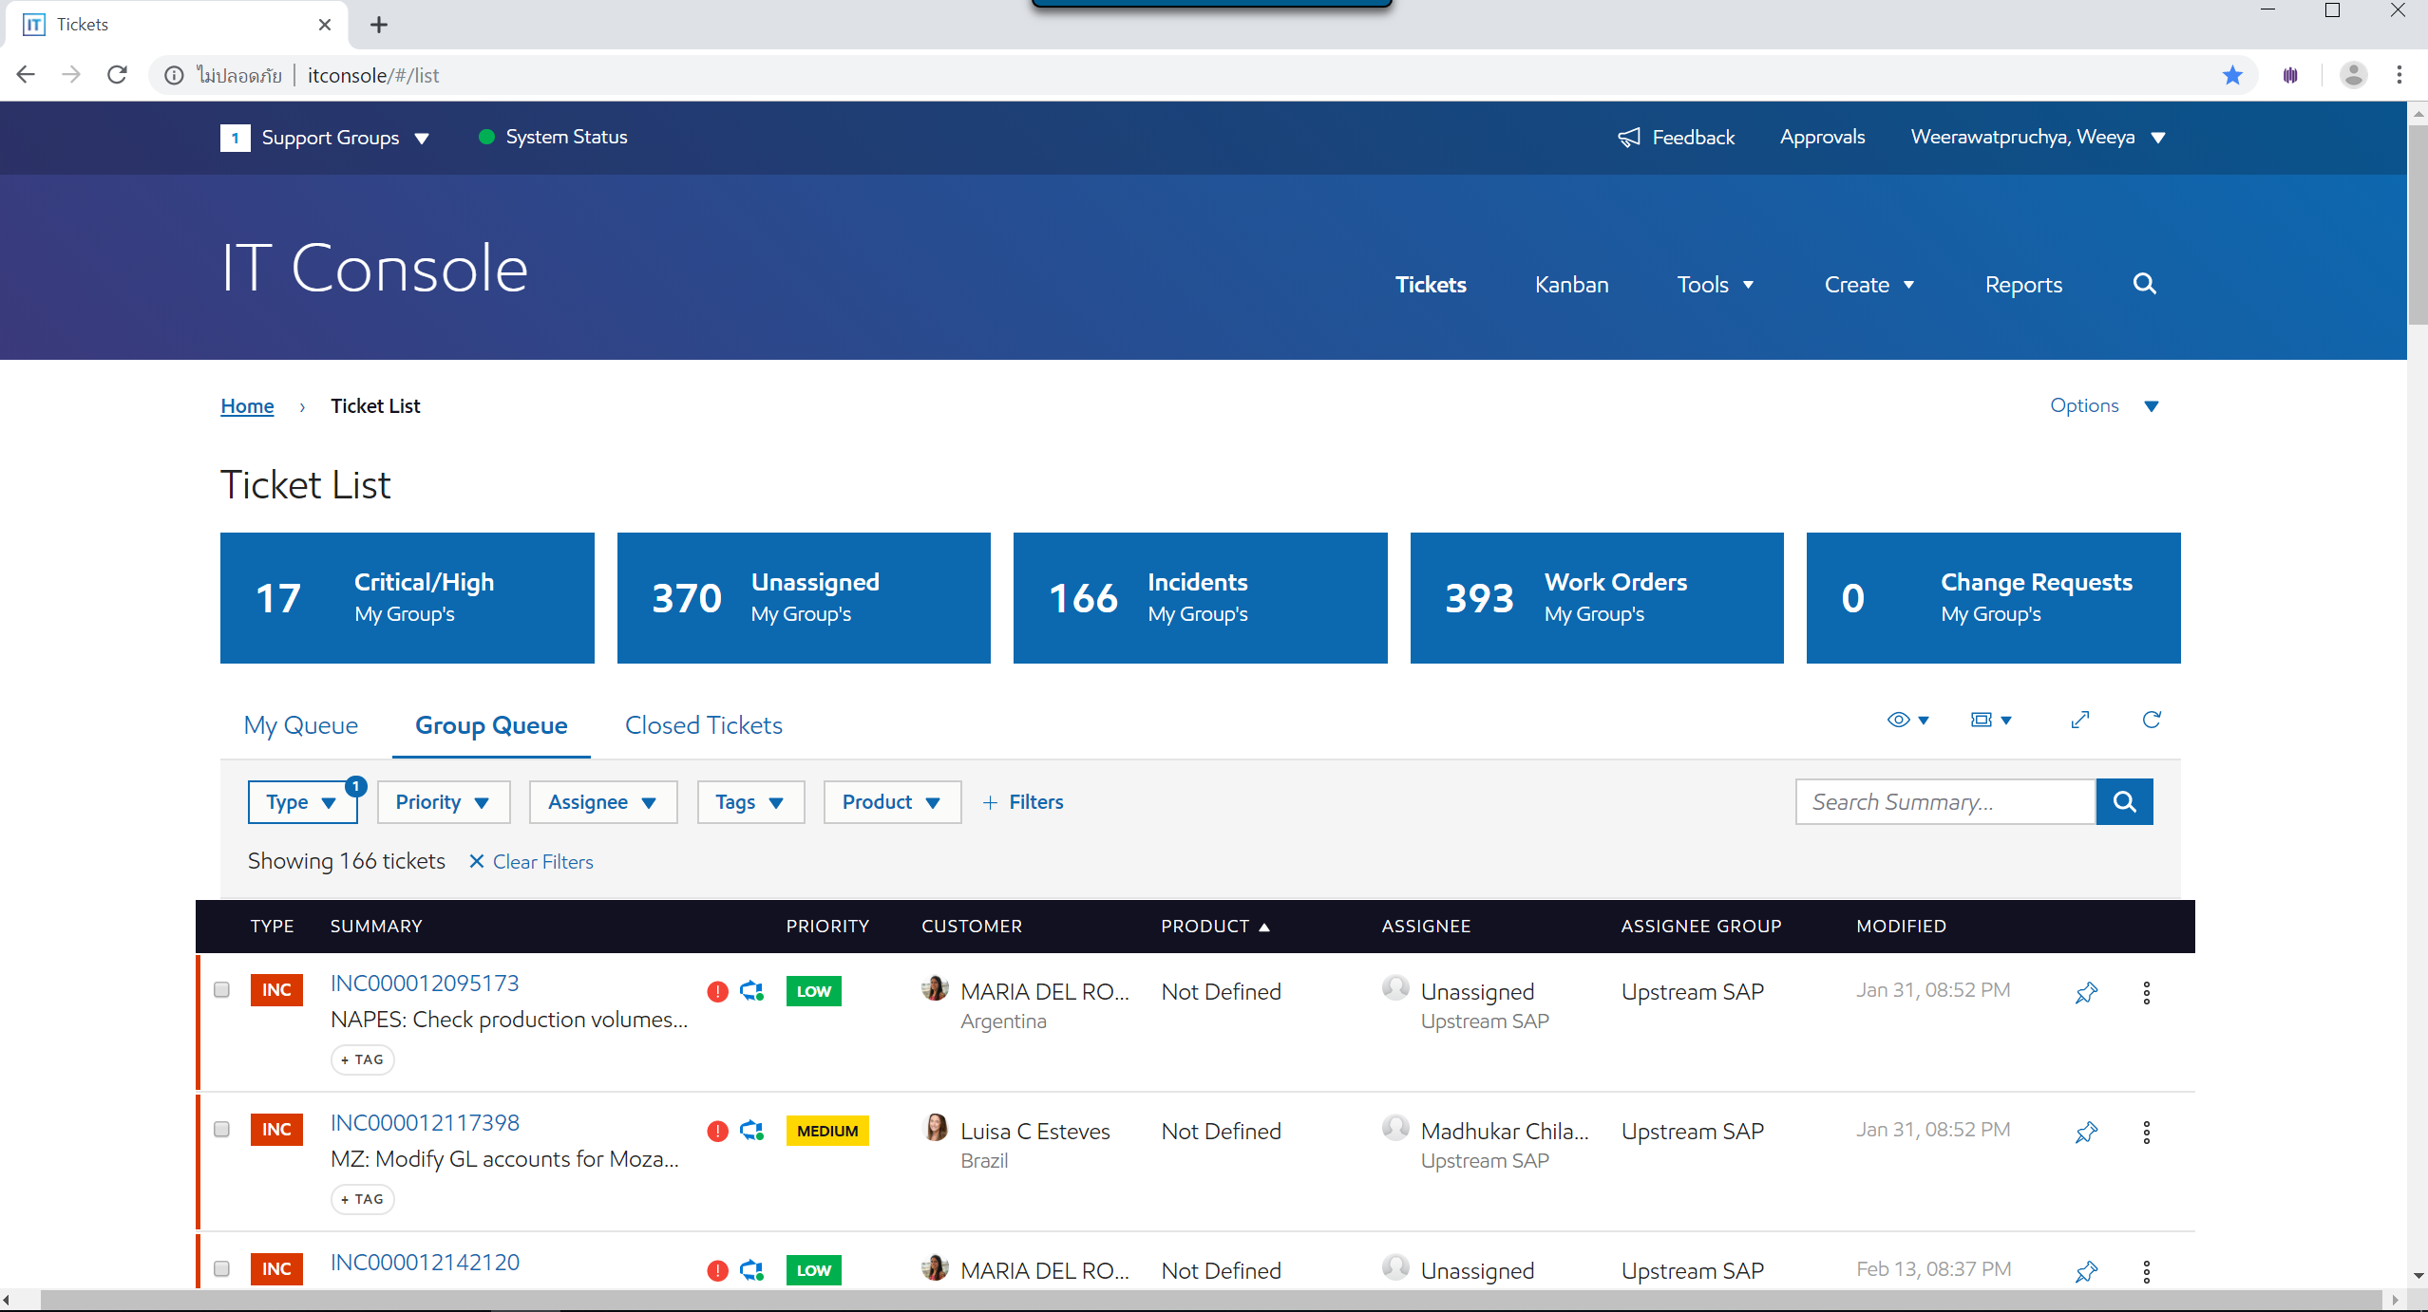

IT Console
Internship
expectation
Team
background
Work
process
Intern
life
Pain point
& Solution
Demo
Users
Notes:
We have tickets and we have IT console the website for display all tickets from users
And this is the real IT console as you can see display all tickets here… and have a filter
But IT console not suitable for our team structure that have 4 sub team ….. All tickets from 4 team in the same page

Slide 12




Classify & Assign tickets
?
FI Upstream SAP
4 sub-teams
?
Thotsakan
Scrumblers
Supernova
Polaris
Notes:
Let’s see how our team classify & assign ticket
We have 4 dispatcher & hundred of tickets

Slide 13
Pain point
Team classification is done manually
Reassign ticket unnoticed
Monitor all time
Contact who?
Internship
expectation
Team
background
Work
process
Intern
life
Pain point
& Solution
Demo

Slide 14

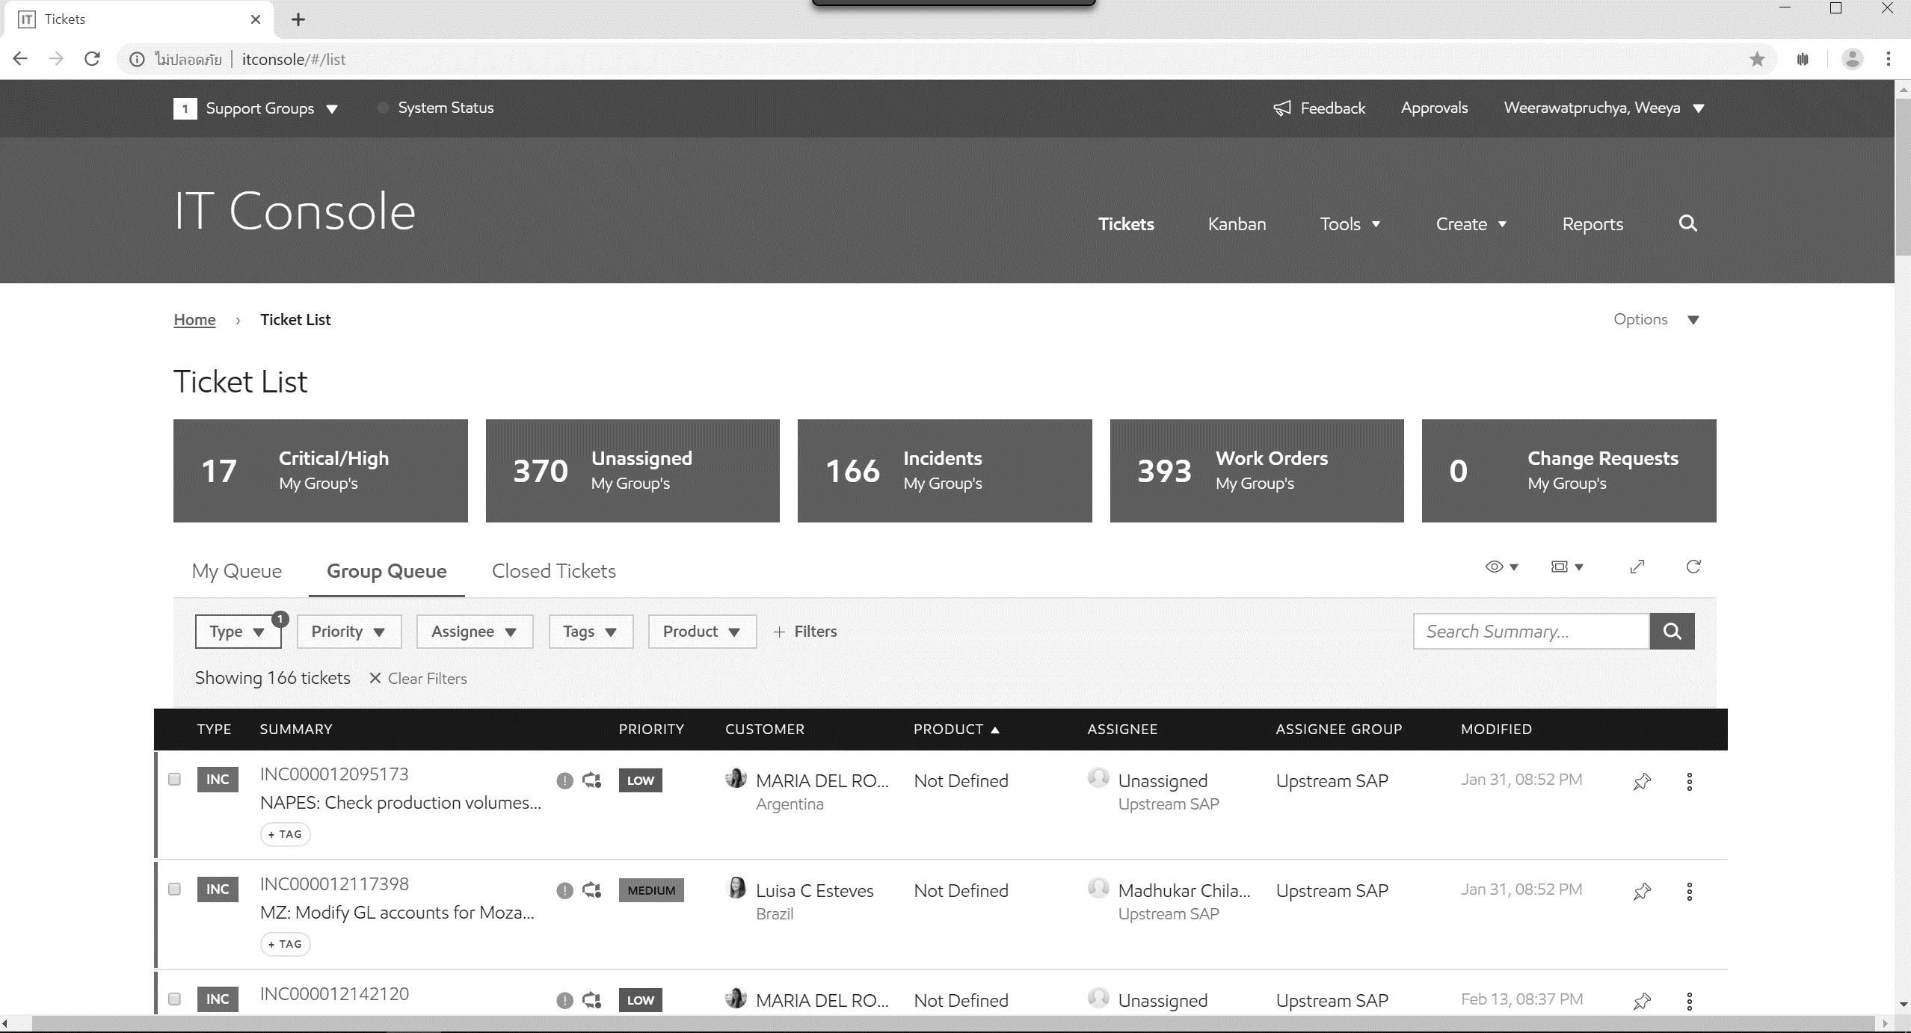
Ticket dispatcher’s life
Notes:
Ticket dispatcher’s life…
In one day ticket dispatcher have to open IT console & start with the first unassign ticket. He have to classify & assign ticket to his team. So he have to read each ticket carefully.

Slide 15
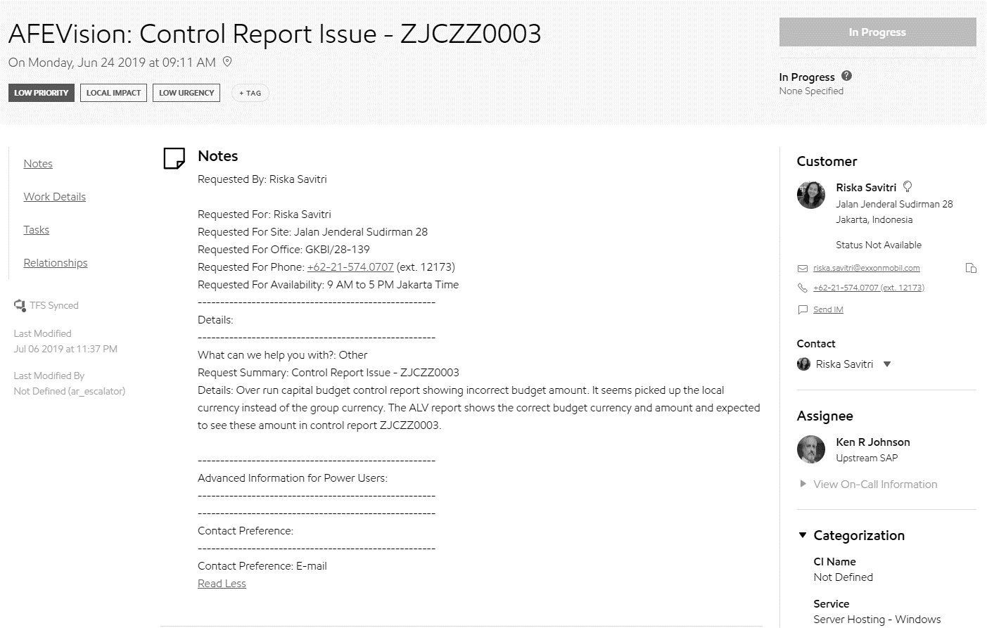
Ticket dispatcher’s life
Notes
Customer
?
Notes:
He start by reading summary & notes line by line to find any keyword, any company code or impacted country & look at customer too.
If the ticket belong to his team he will assign to his team member if not he just skip this ticket and back to fist page.

Slide 16
Ticket dispatcher’s life
1st Pain point
Notes:
And continue doing the same thing ticket by ticket manually
That is the first pain point.

Slide 17
Ticket dispatcher’s life
Yesterday …
INC000012142120
Notes:
He continue reading ticket…
Until the last ticket that he have already done yesterday that he have to remember by himself.

Slide 18
Ticket dispatcher’s life
2nd Pain point
Done
Notes:
Sometime ticket reassign from other support group and it come in the middle … & ticket dispatcher maybe unnoticed that ticket
That the second pain point.

Slide 19

Ticket dispatcher’s life
3rd Pain point
Monitor
IT Console
Notes:
Moreover ticket dispatcher have to monitor ticket all the time … have any new ticket come in
& manually refresh IT Console
That is the third pain point.

Slide 20

Ticket dispatcher’s life
4th Pain point
Contact?
Notes:
Sometime when ticket dispatcher have a problem … for example about reassign
He have no idea who he will contact with.

Slide 21
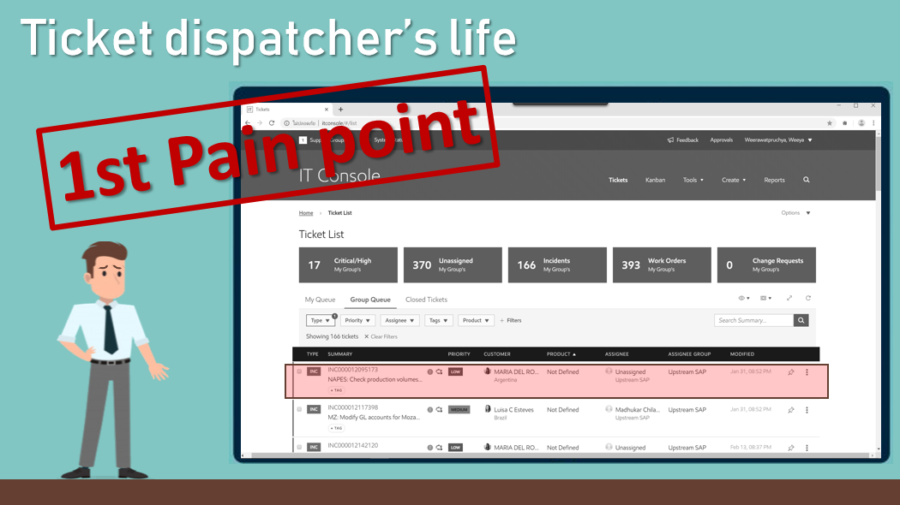
Solution
Internship
expectation
Team
background
Work
process
Intern
life
Pain point
& Solution
Demo
Team classification

Slide 22
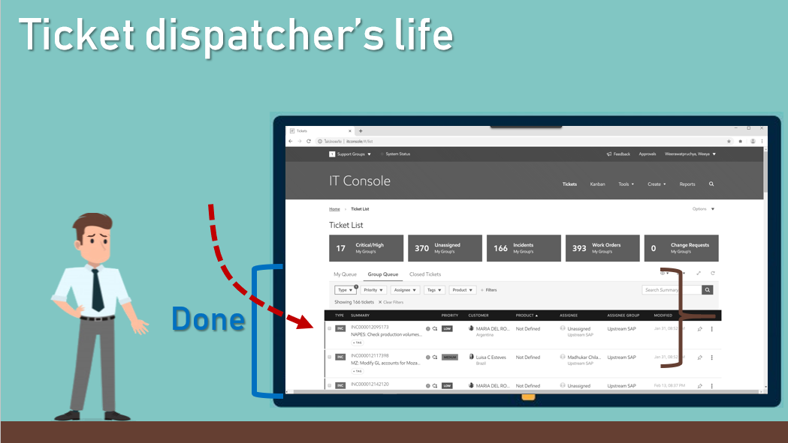
Solution
Sort ticket by modified date
Instead of submit date

Slide 23
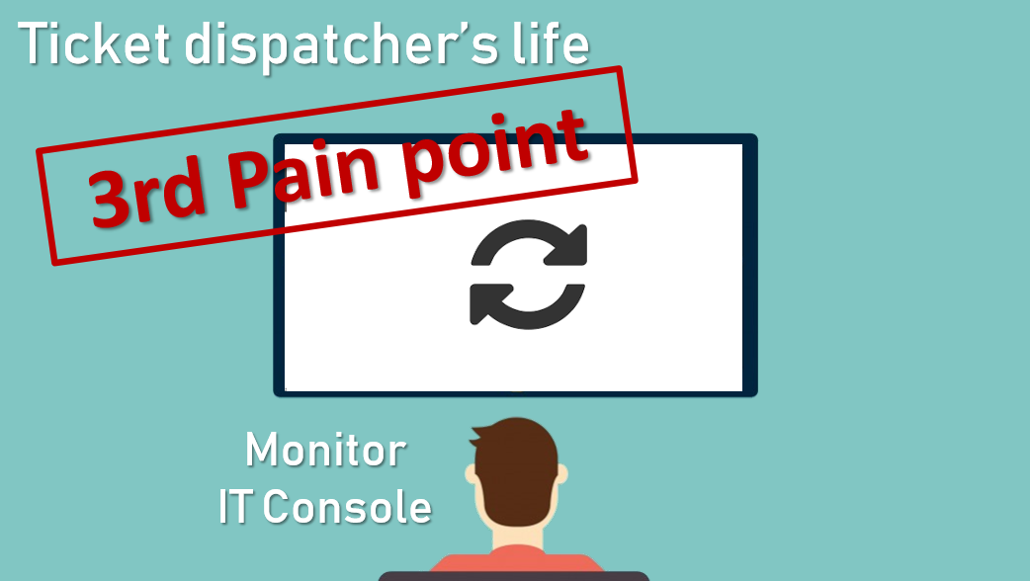
Solution
Notification & Auto refresh

Slide 24
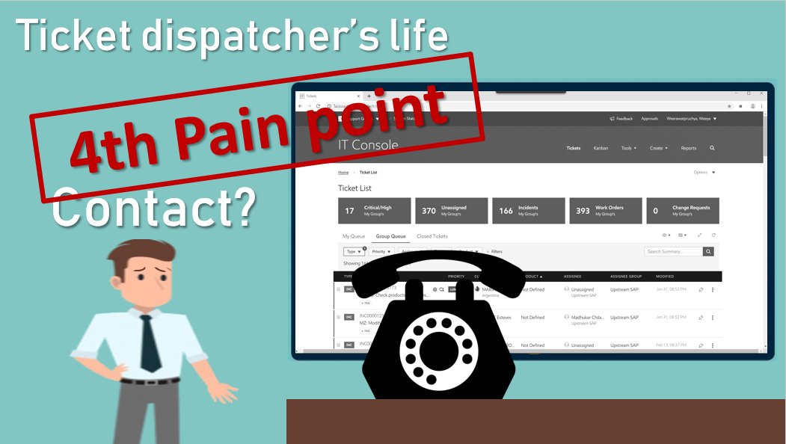
Solution
Display ticket dispatcher

Slide 25




Work process
Internship
expectation
Team
background
Work
process
Intern
life
Pain point
& Solution
Demo
Agile
methodology
Scrum
framework

Slide 26
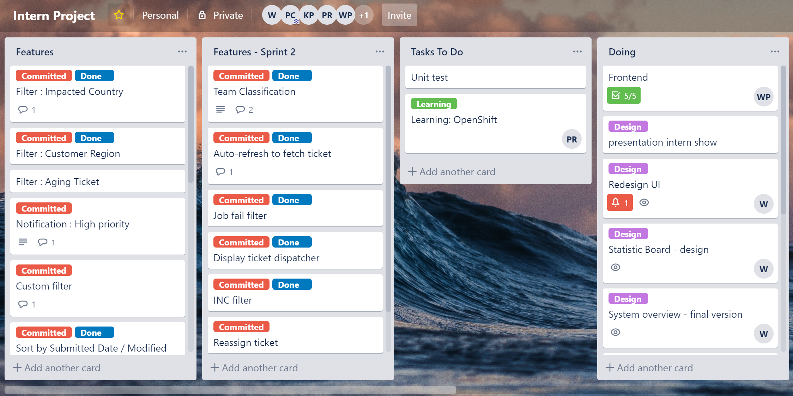

Slide 27
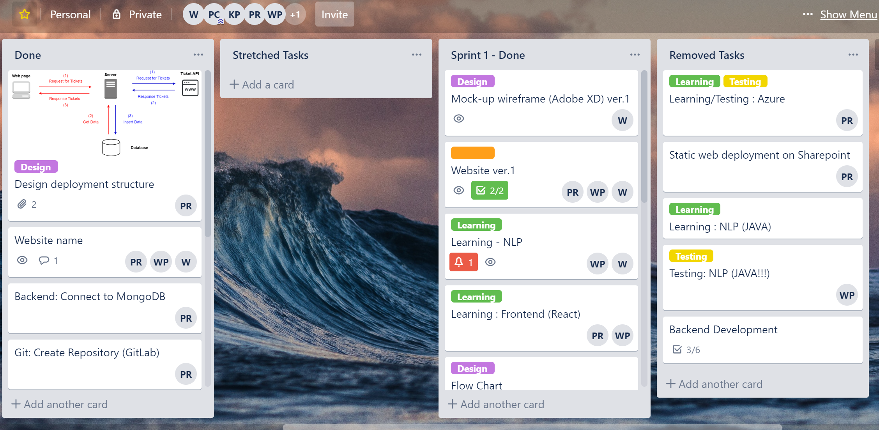

Slide 28
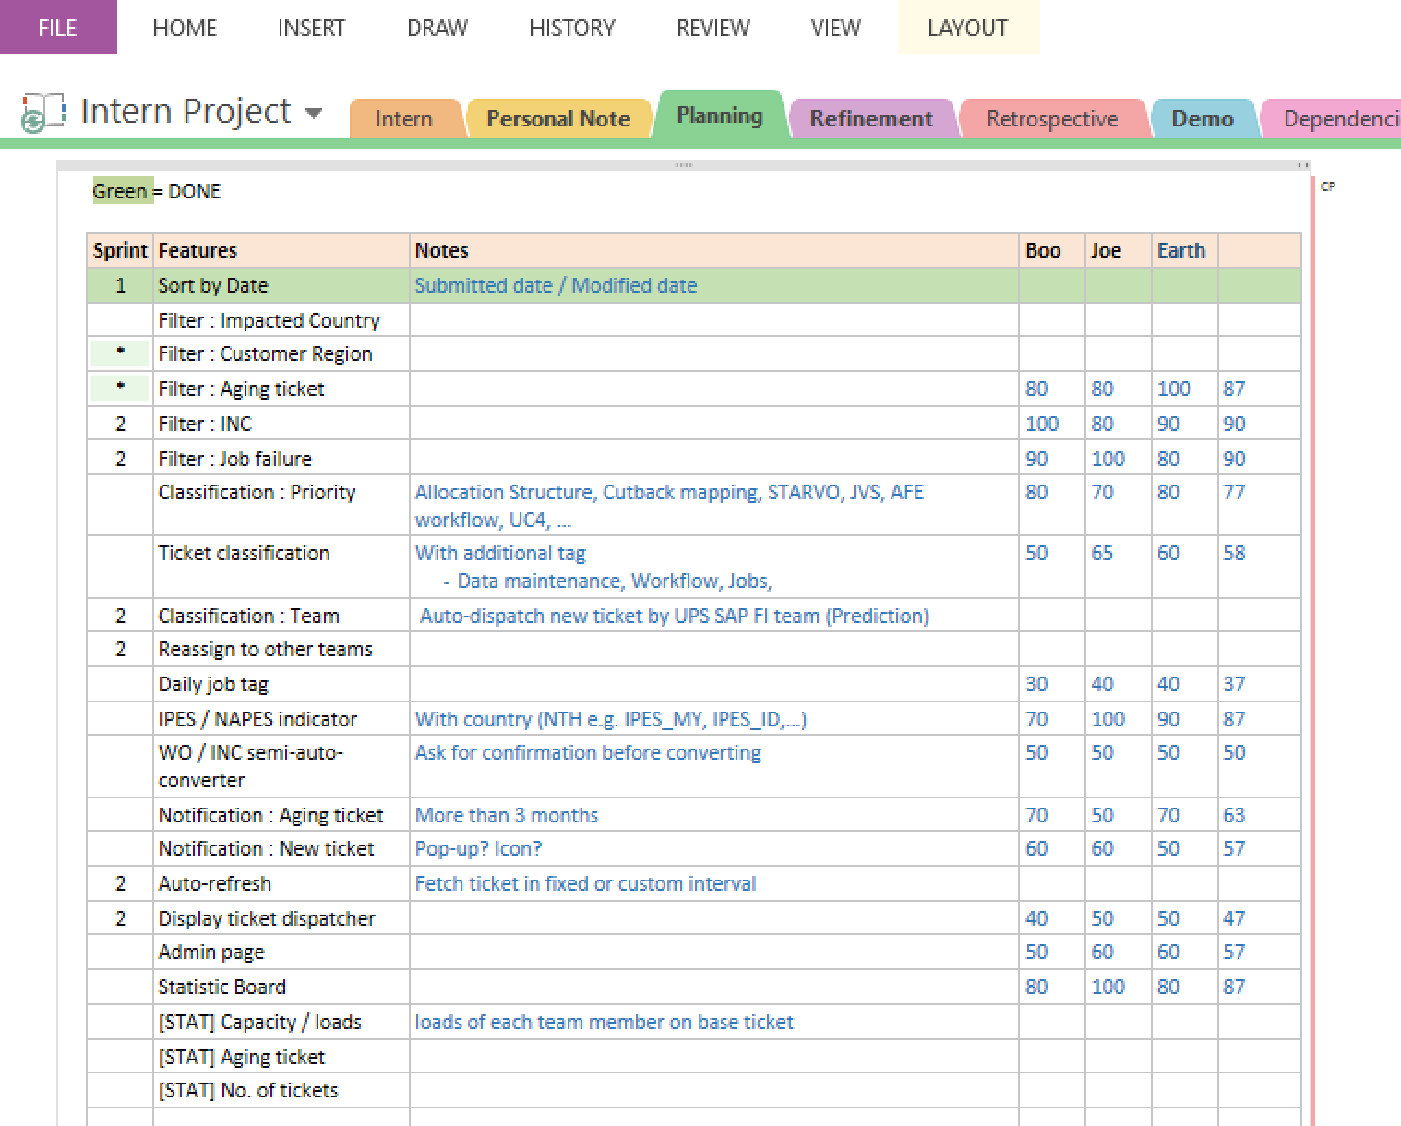
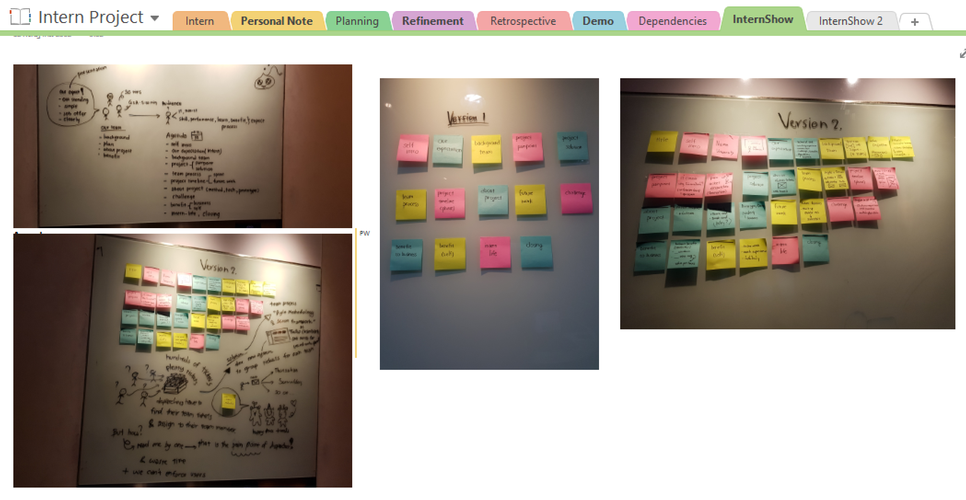

Slide 29
Timeline
Phase 1
Phase 2
2months
4months

Slide 30
Phase 1 (2 months)
Sprint 1
Sprint 2
Sprint 3
Gather requirements
Learn development tools
Design wireframe and UI version 1
Design system overview version 1
Make website version 1
Rewrite some logics
Refactor code (optimize and clean code)
Prepare for Interns show presentation
Redesign UI (version 2)
Redesign system overview
Make website version 2
Use version control (GitLab)

Slide 31
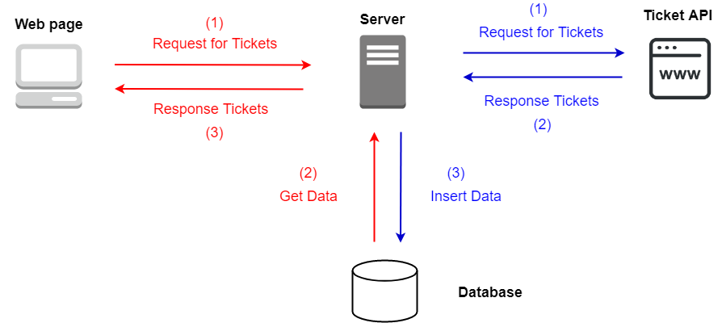
System overview

Slide 32
Progress (system overview & flow chart)

Slide 33

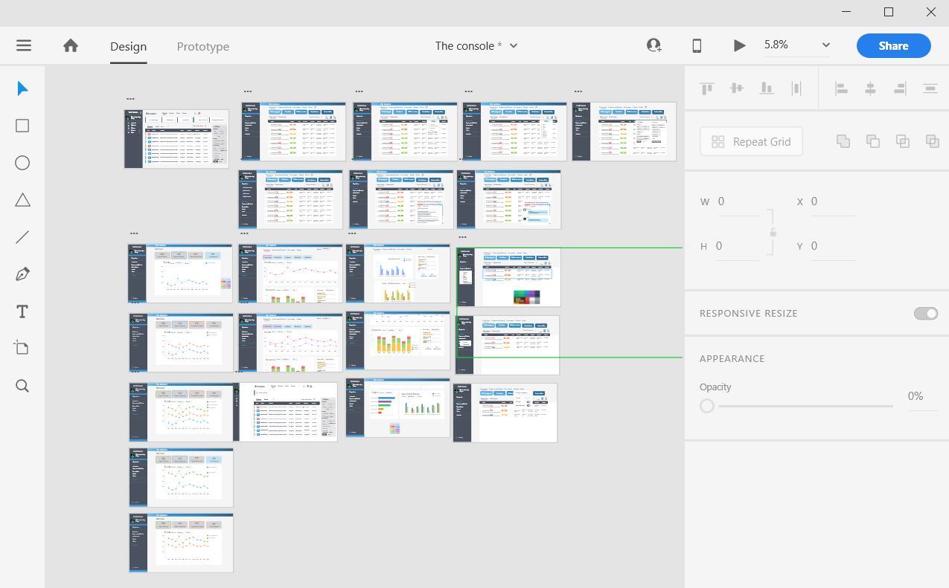
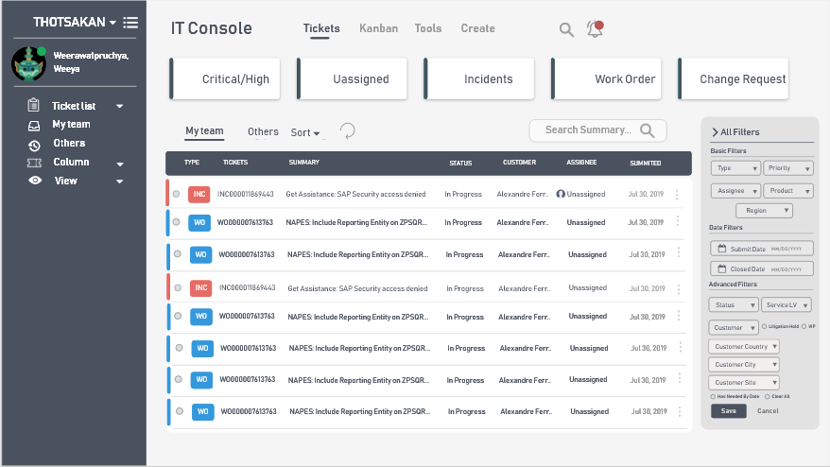
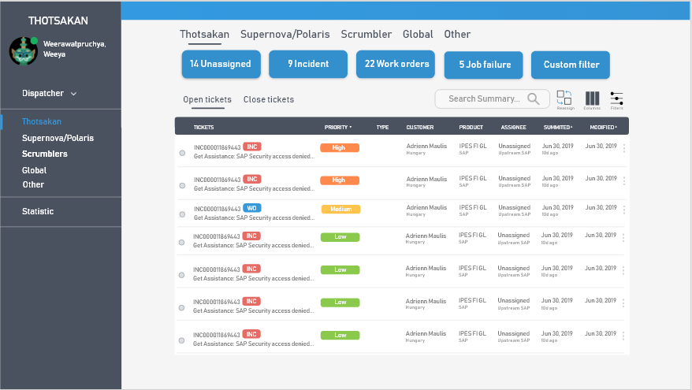
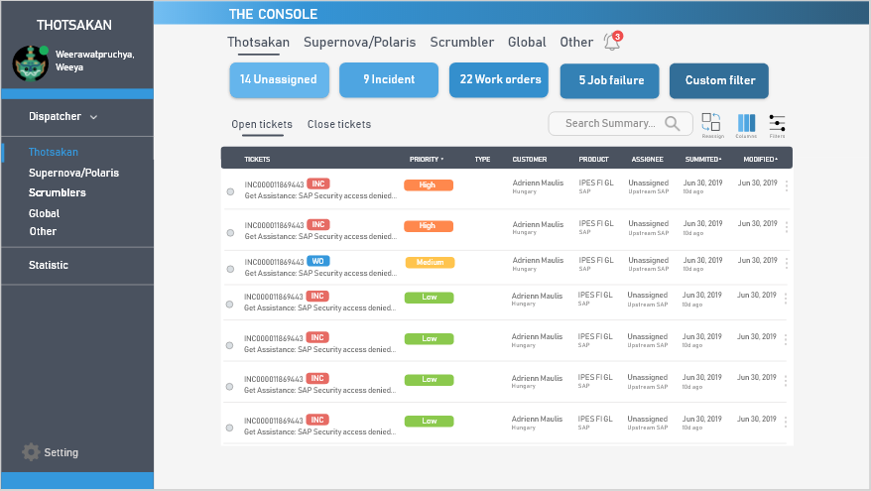
Technologies – Design
Website wireframing
Creating simple interactive click-through prototypes
Adobe XD
Team
Menu bar
Display tickets

Slide 34


Technologies – Front End
Building website user interfaces
React

Slide 35



Technologies – Backend
Python: it has many libraries for text processing
Flask: for deployment to the web server, its easy to use & more light weight than other framework
MongoDB:
Python

Slide 36
demo
Internship
expectation
Team
background
Work
process
Intern
life
Pain point
& Solution
Demo

Slide 37
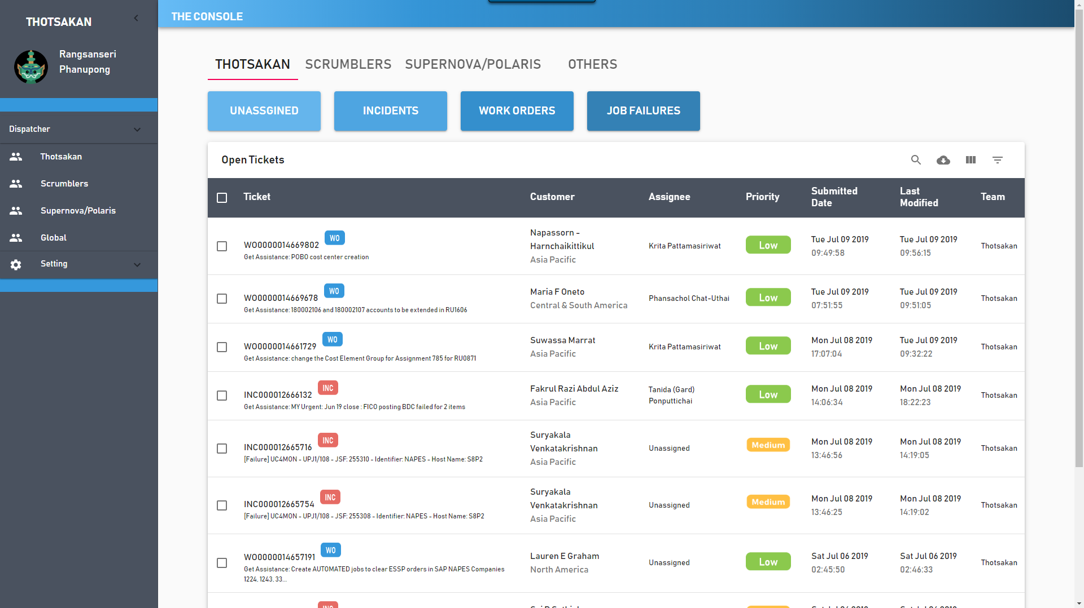
Home page

Slide 38
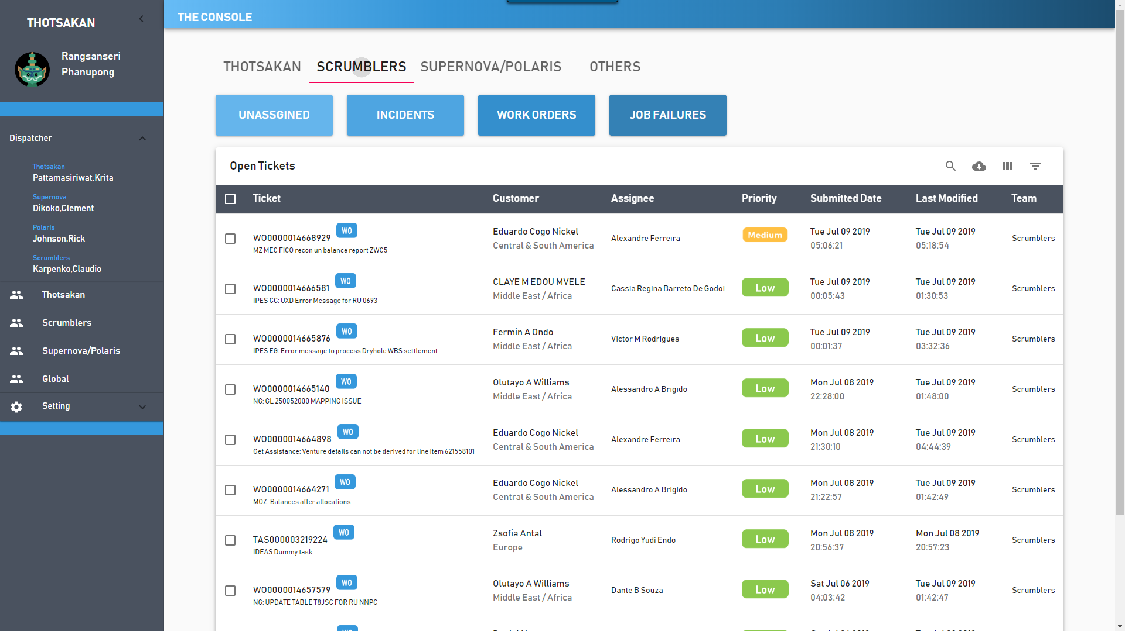
Team classification

Slide 39
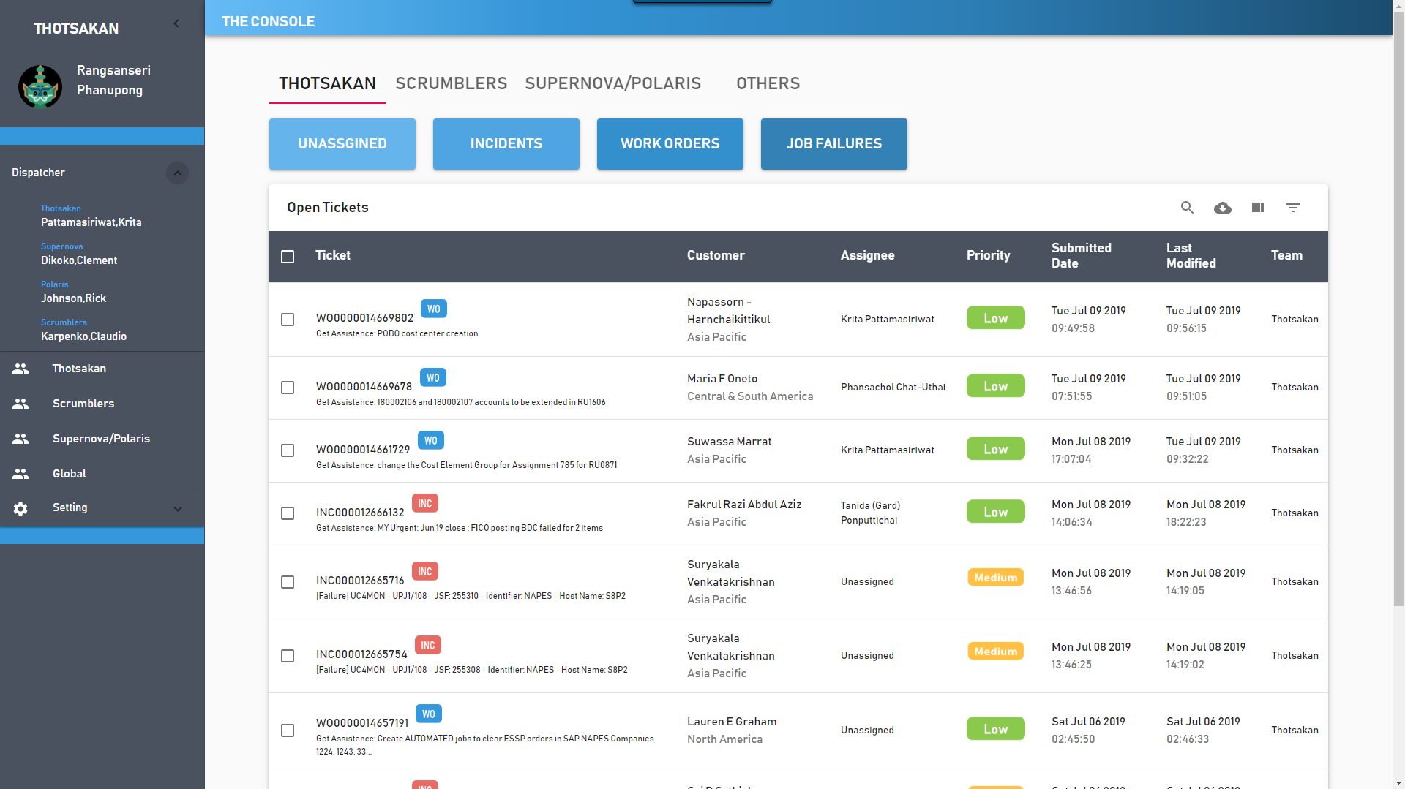
Display dispatcher

Slide 40
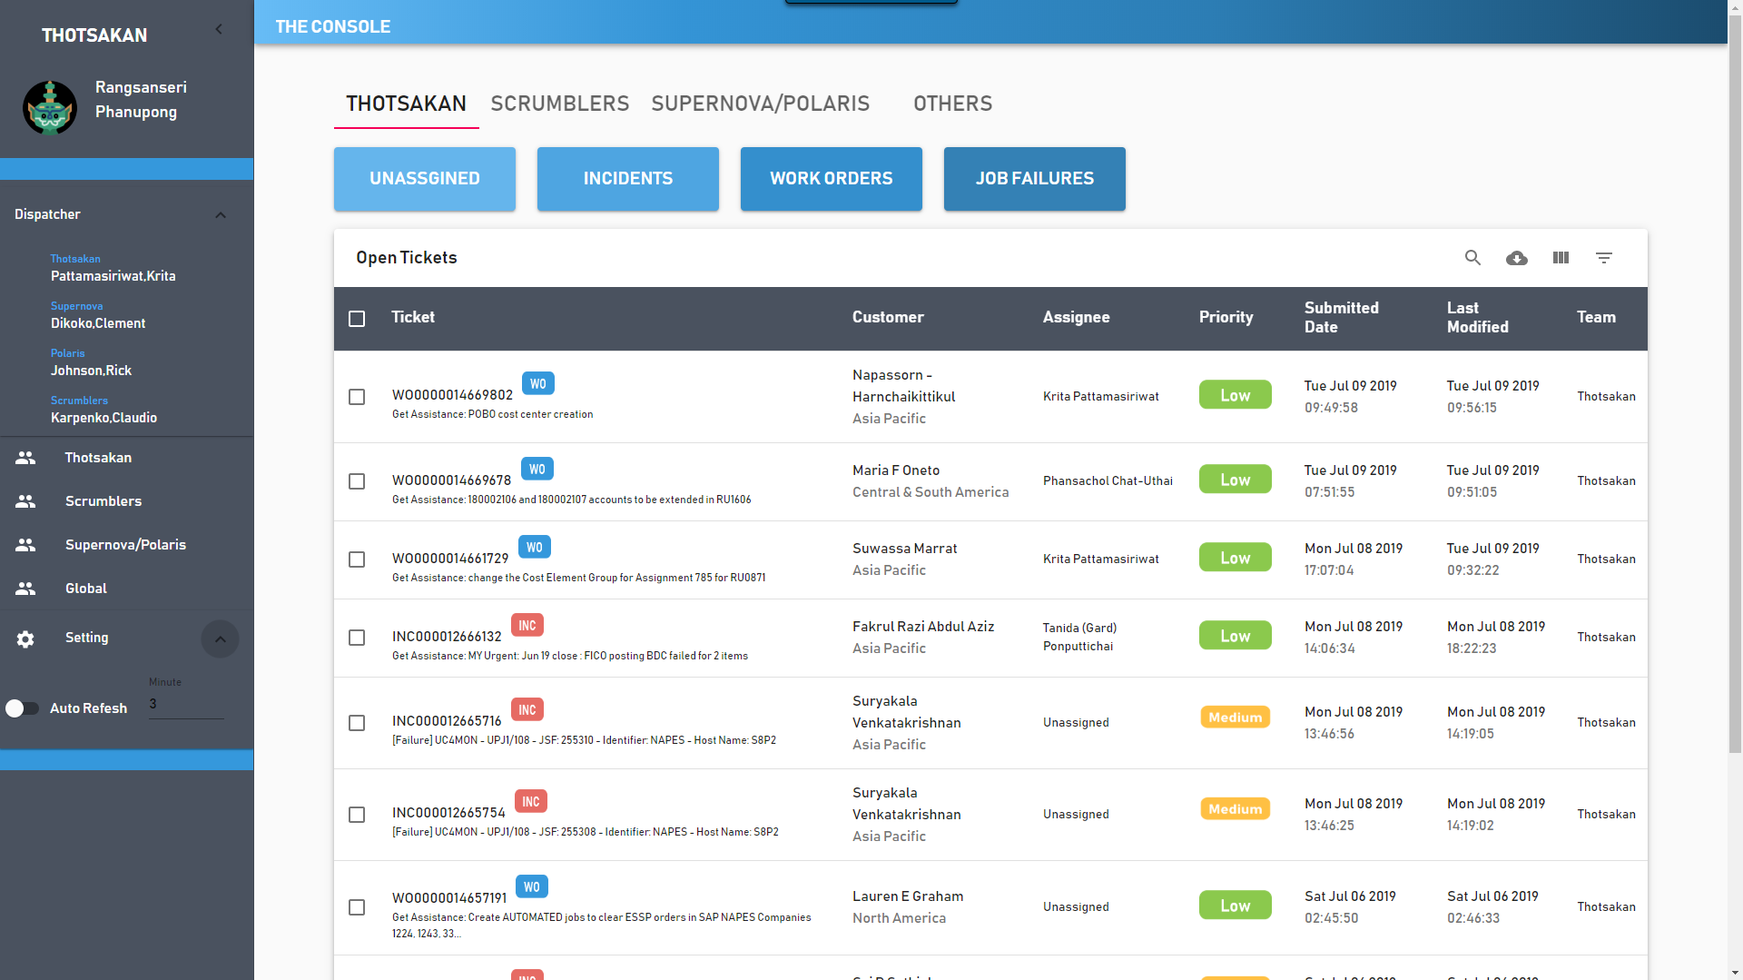
Auto refresh

Slide 41
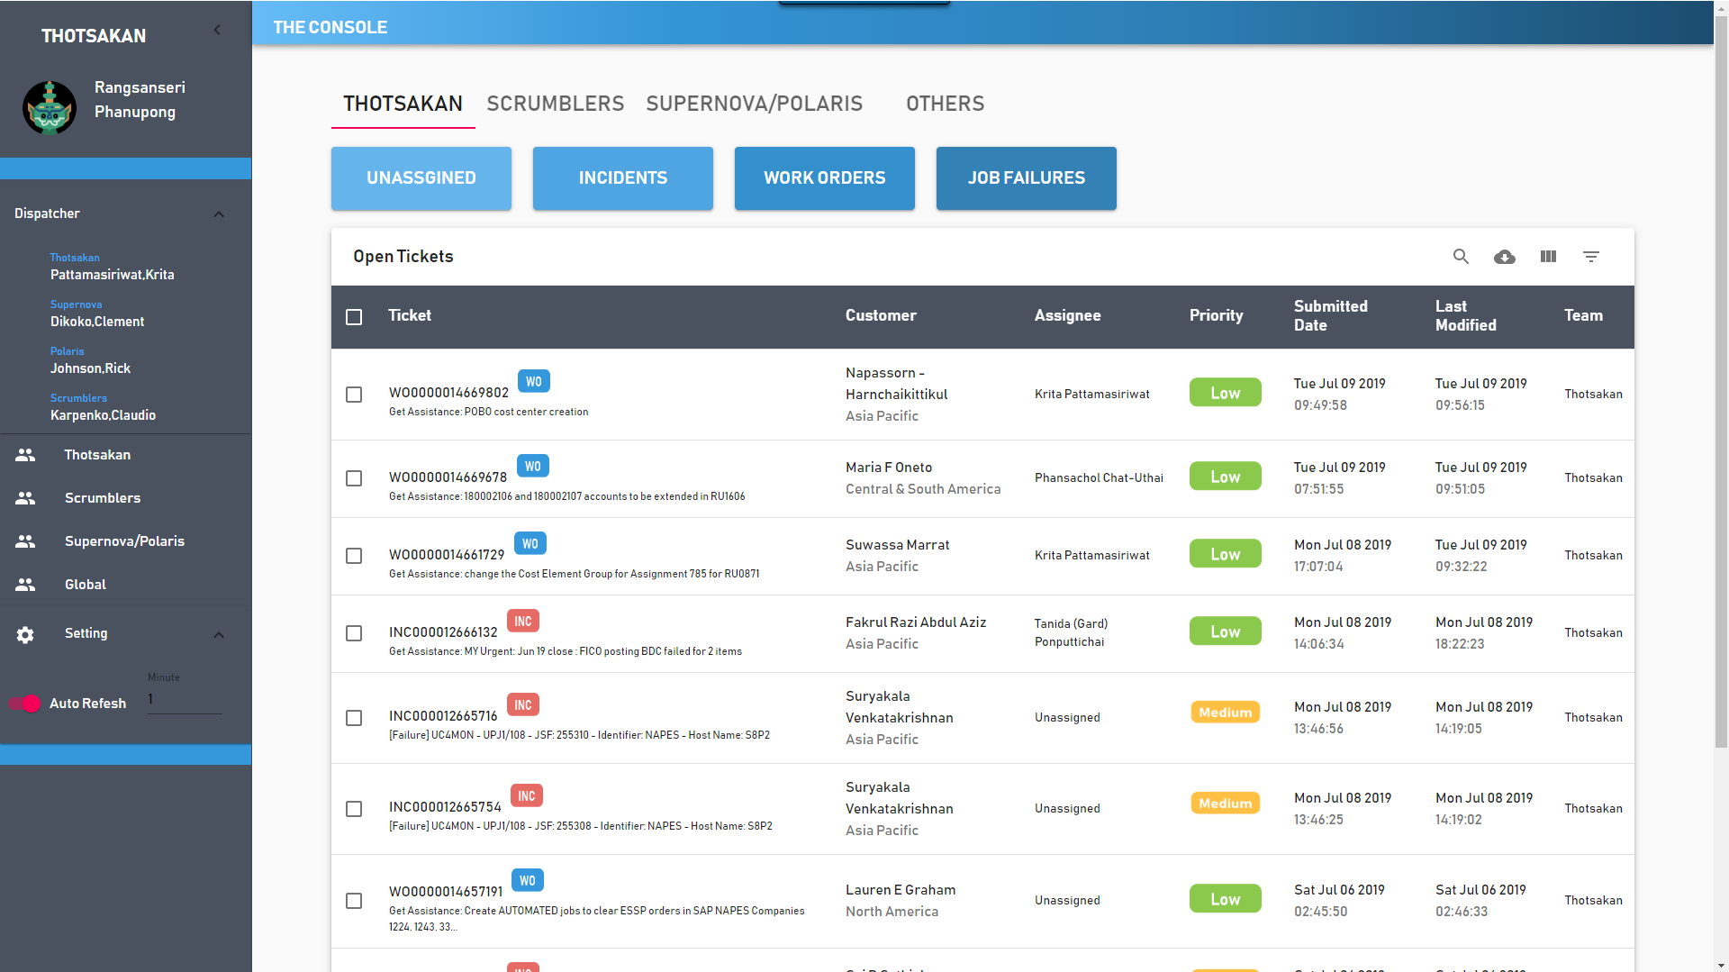
Auto refresh

Slide 42
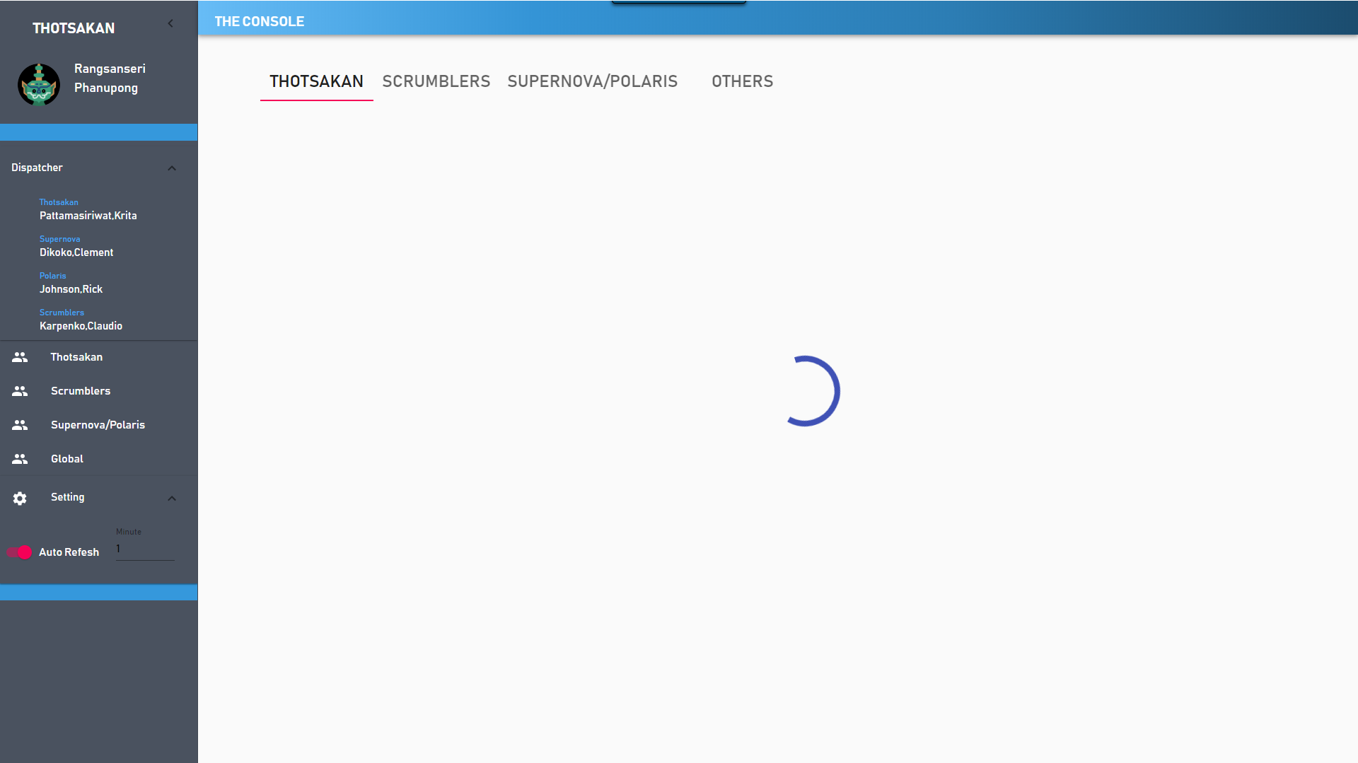
Auto refresh

Slide 43
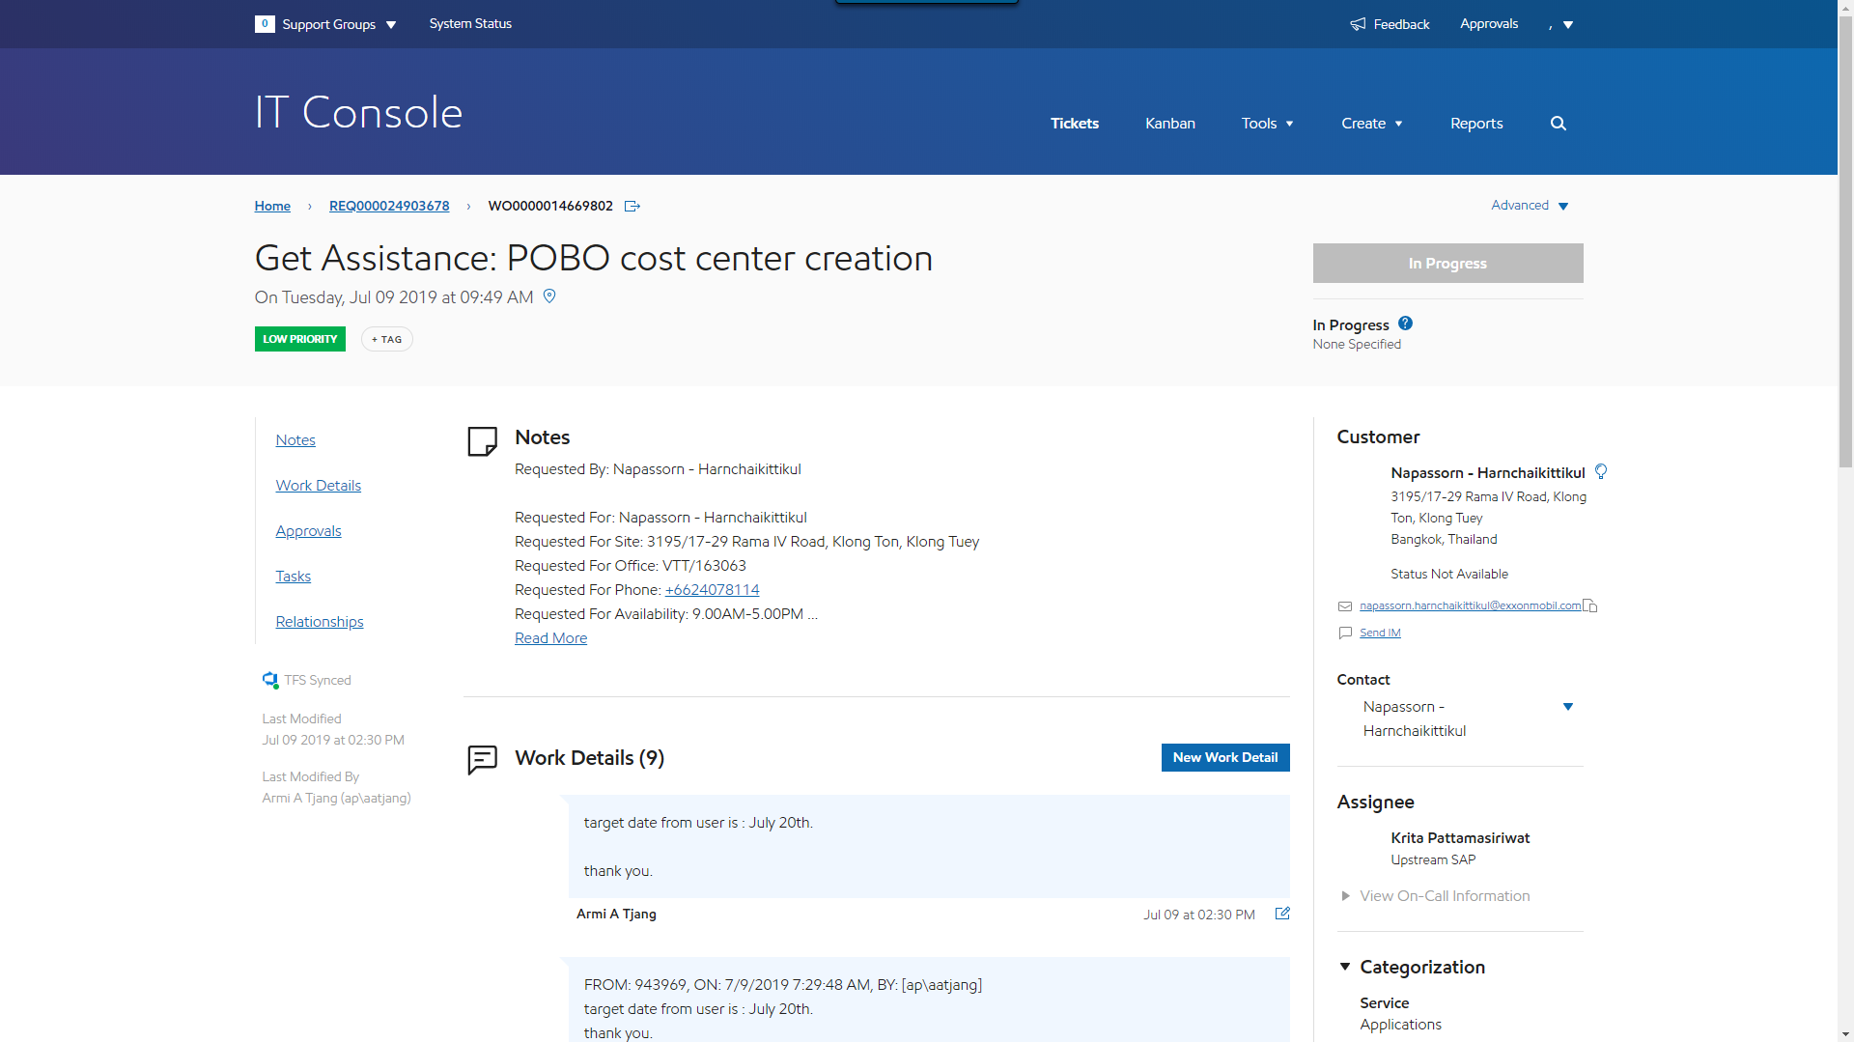
Ticket detail

Slide 44
Future work
Phase 2 (4 months)
Notification
Statistics page
ITSM’s ticket info update
Notes:
Statistics and deploy

Slide 45
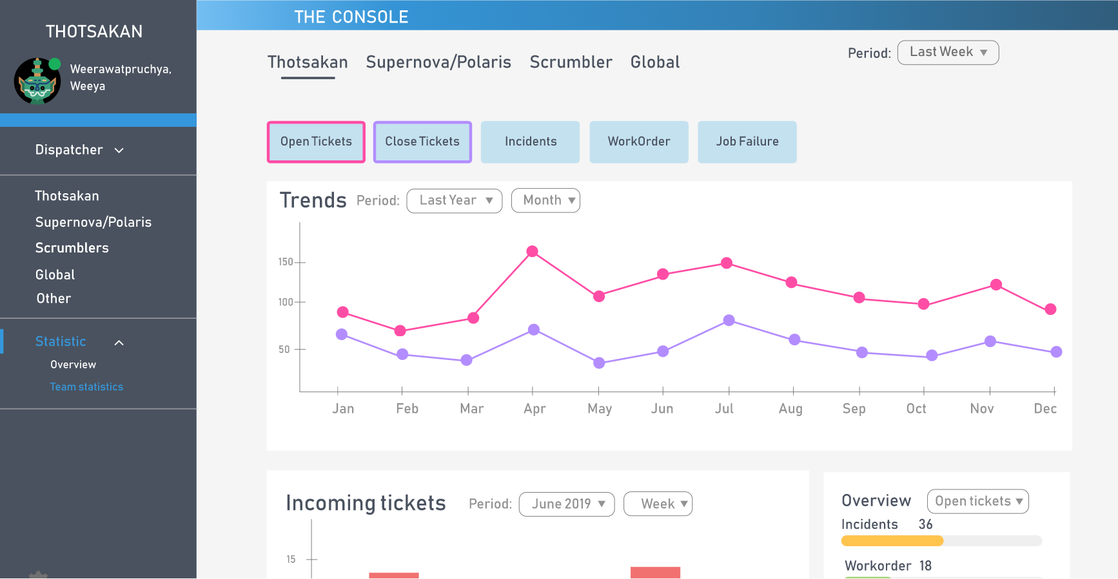
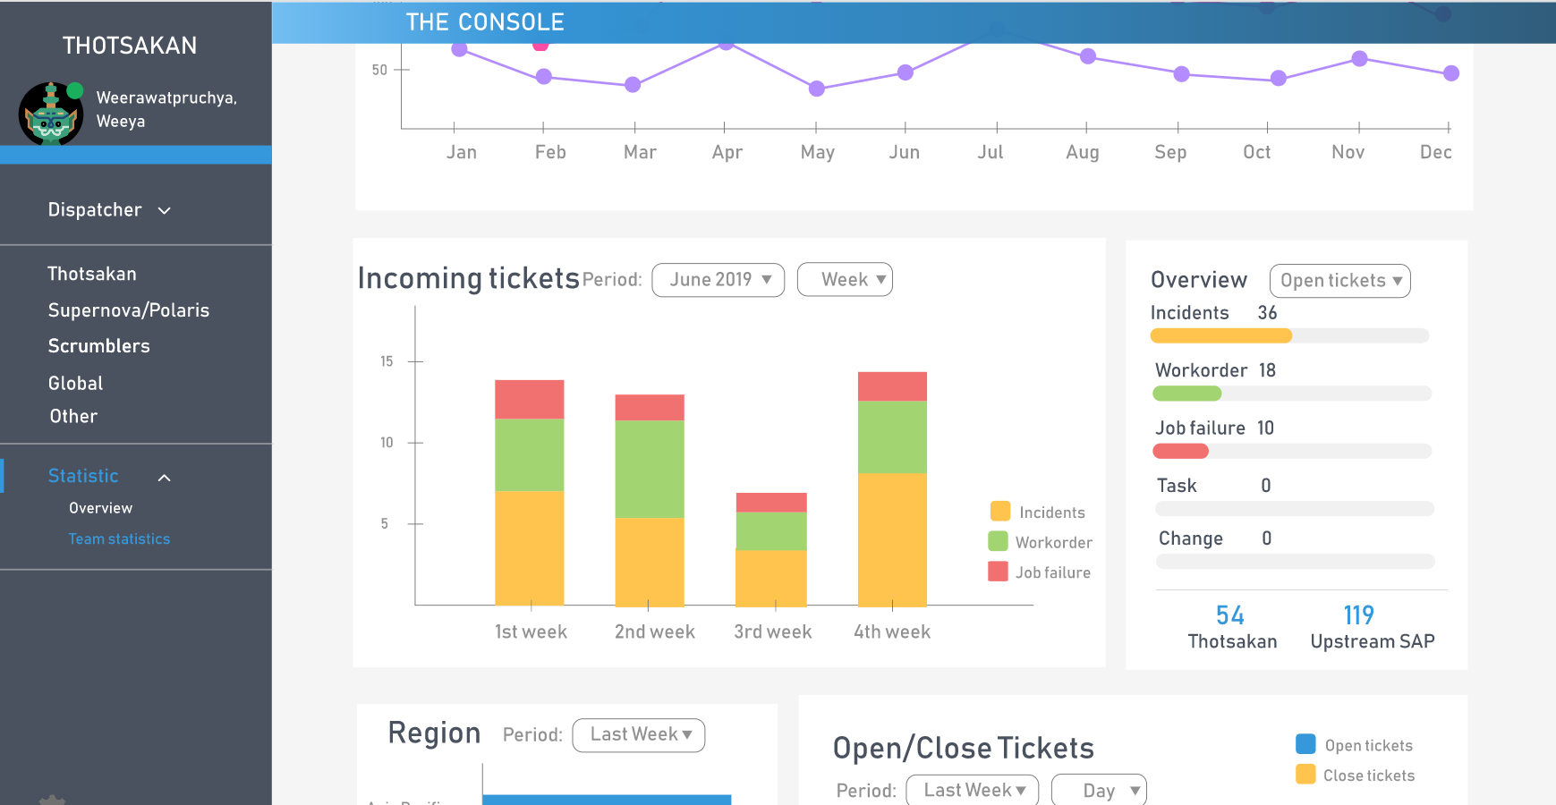
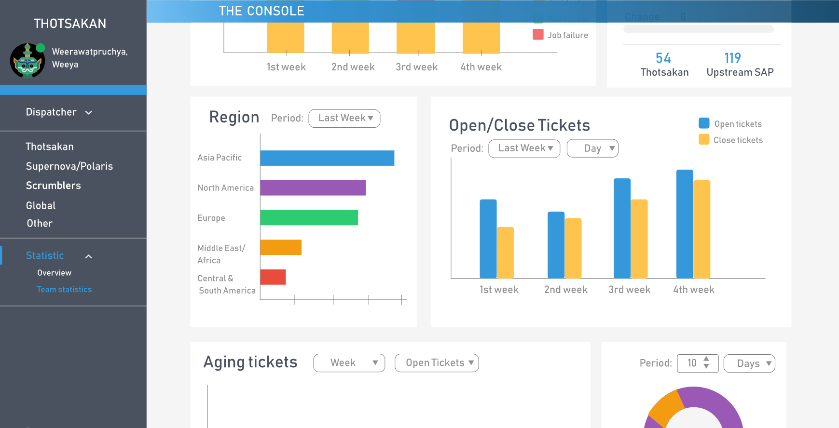
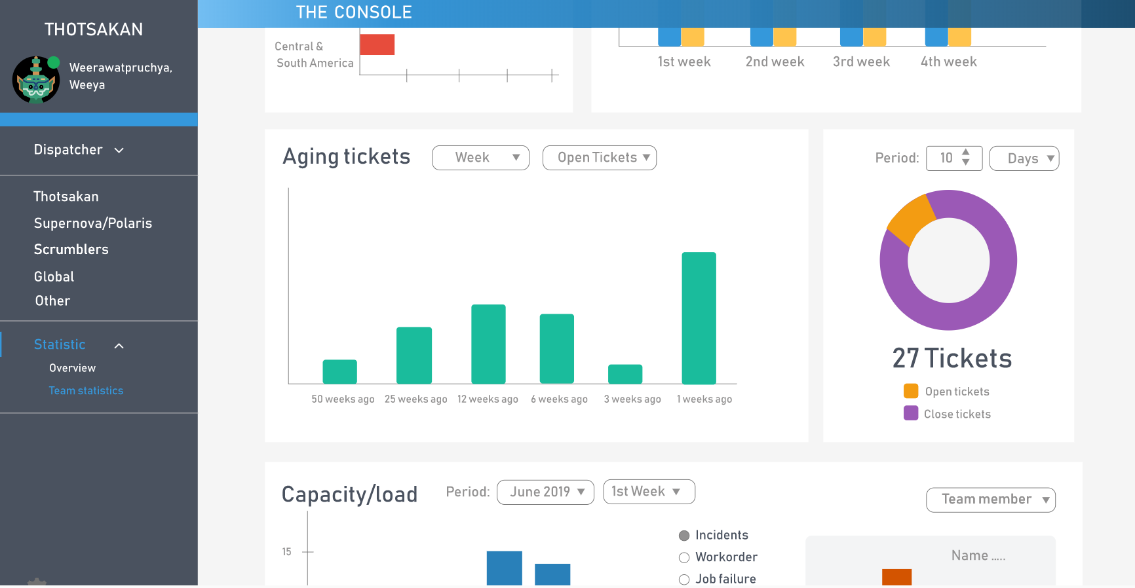

Slide 46


Benefit to team
Reduce times usage
Improve efficiency

Slide 47


Challenge
Collaborations with new friends
Adapt to project's requirement changing
Time limitation
Speak English

Slide 48
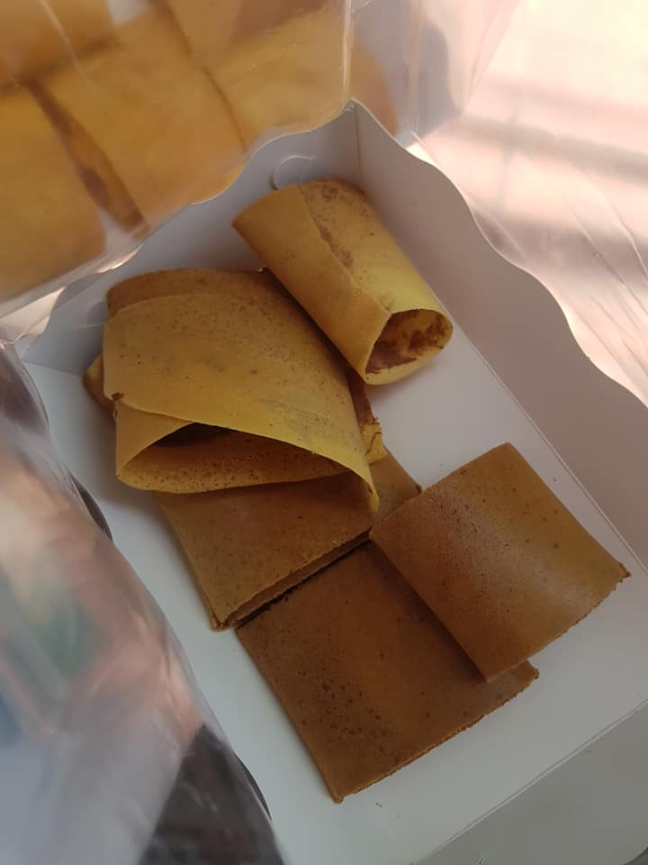
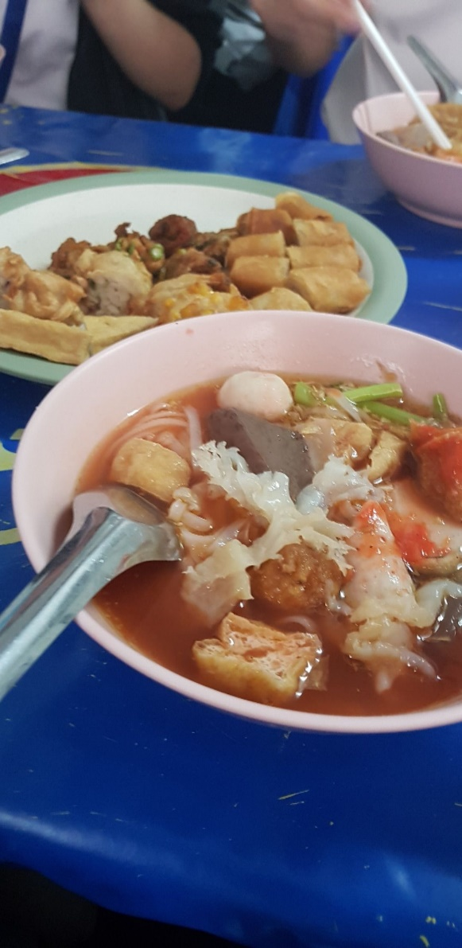


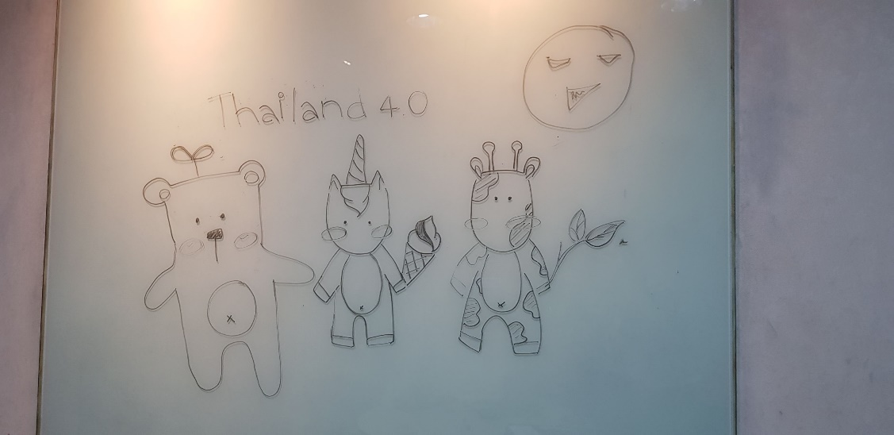
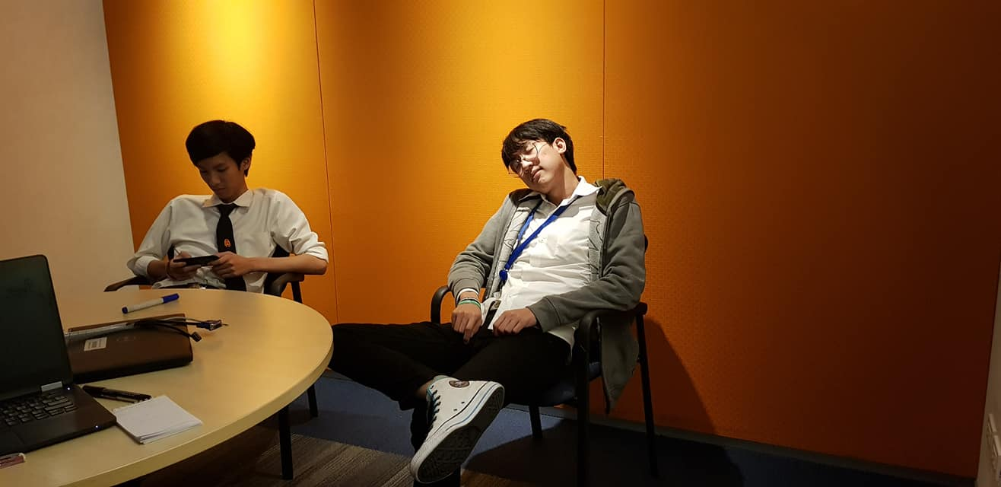

Slide 49
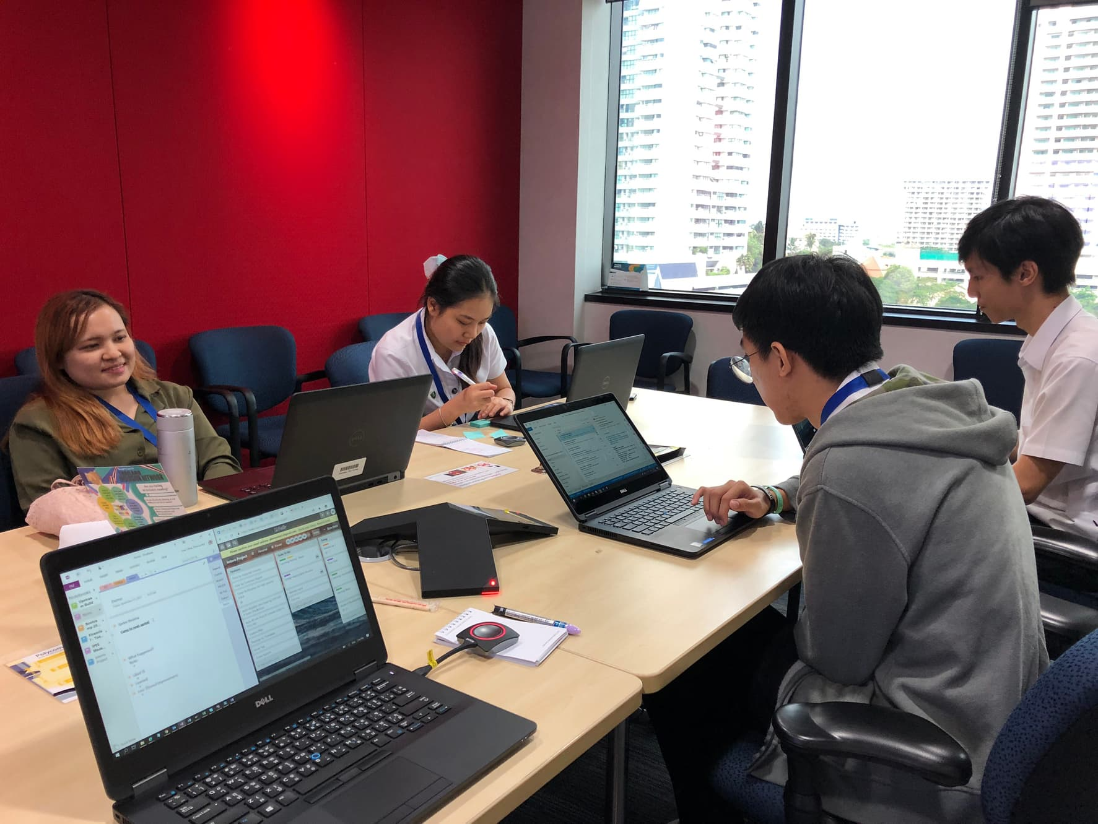
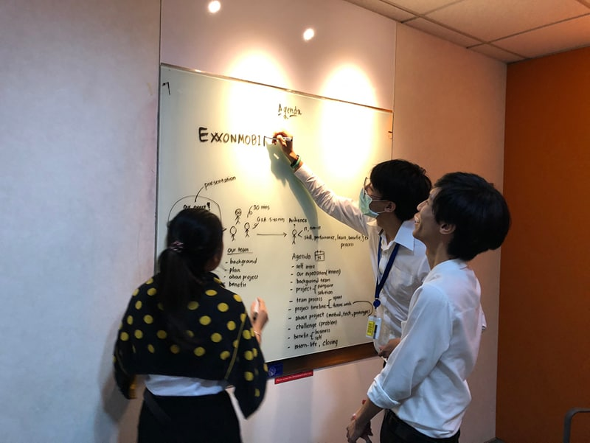
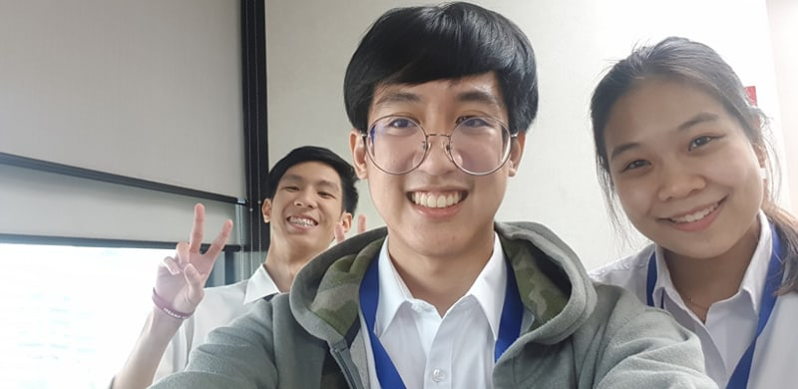
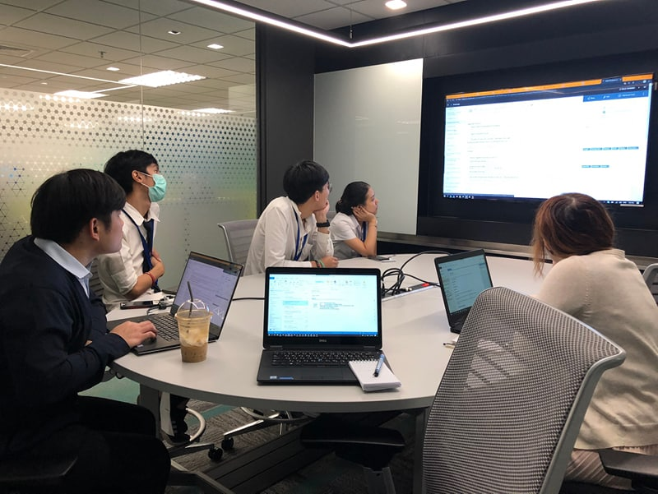

Slide 50
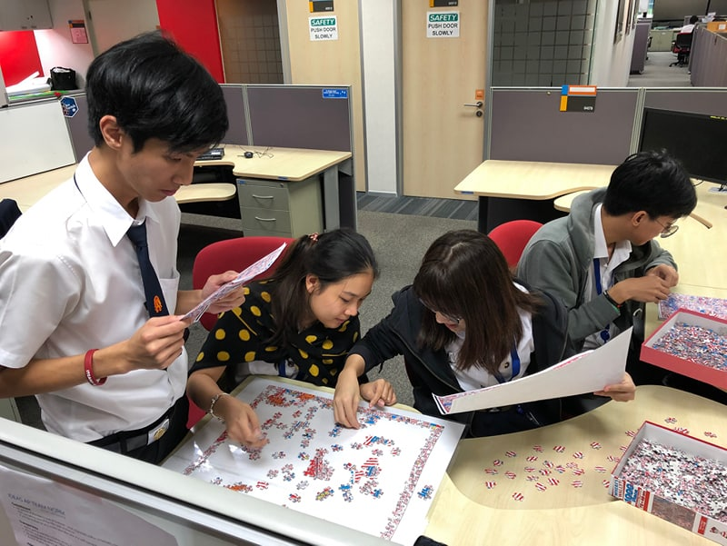
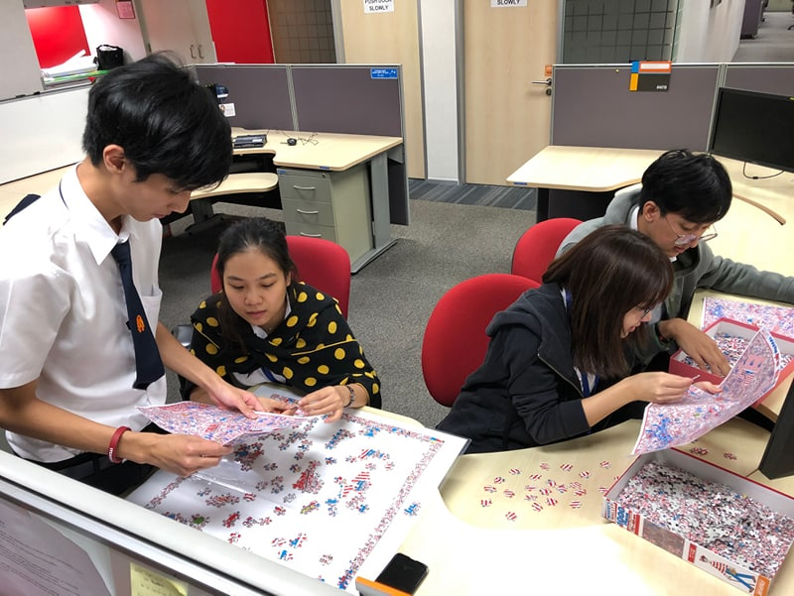

Slide 51
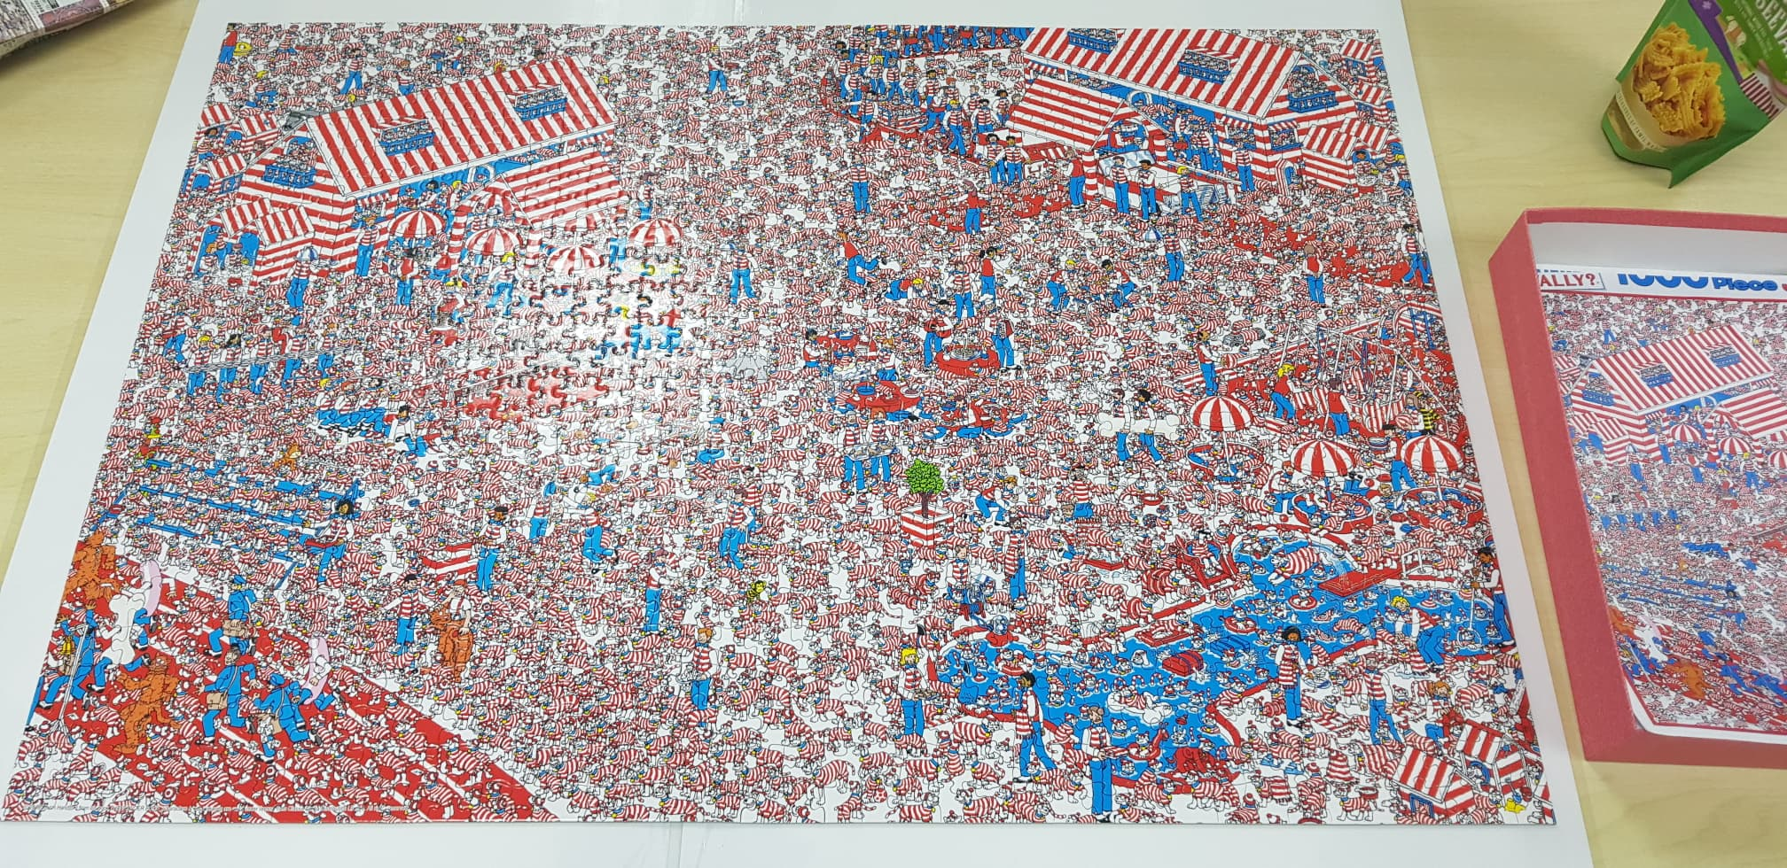

Slide 52
If you only do what you can do,
You’ll NEVER BE BETTER
Than what you are.
-Master Shifu-

Slide 53
Q & A

Slide 54
Team
Menu bar
Display tickets

Slide 55
